Slide 1


DAD 5301 : Security Policy
and International Relationship
安全政策与国际关系
Asst.Prof.Dr.Uea-umporn Tipayatikumporn

Slide 2
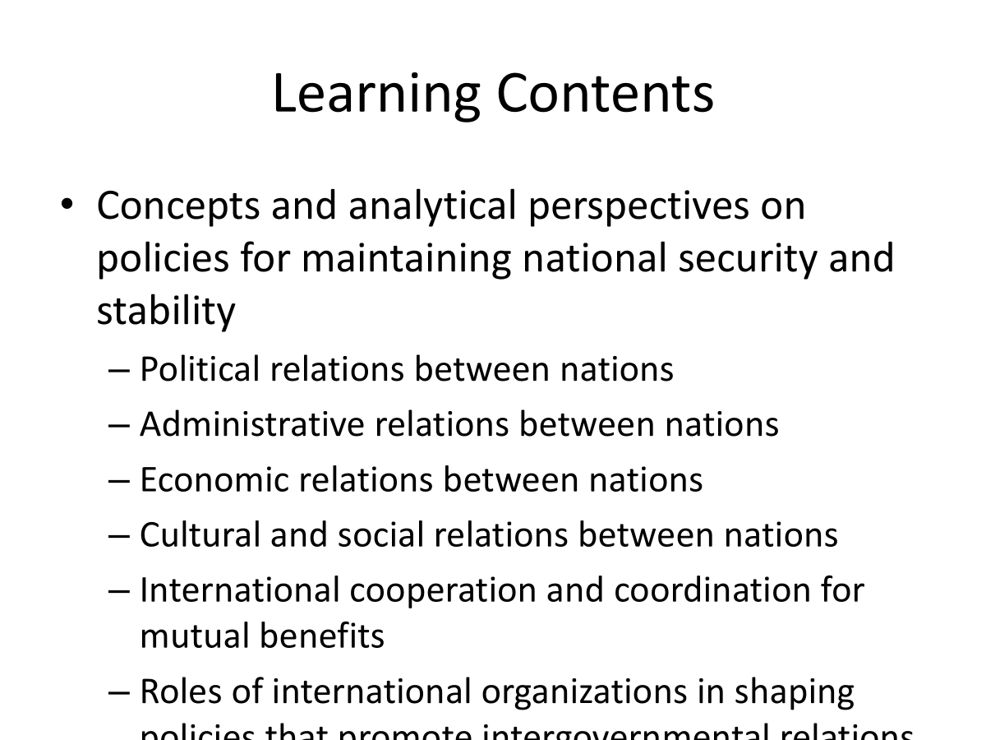

Slide 3
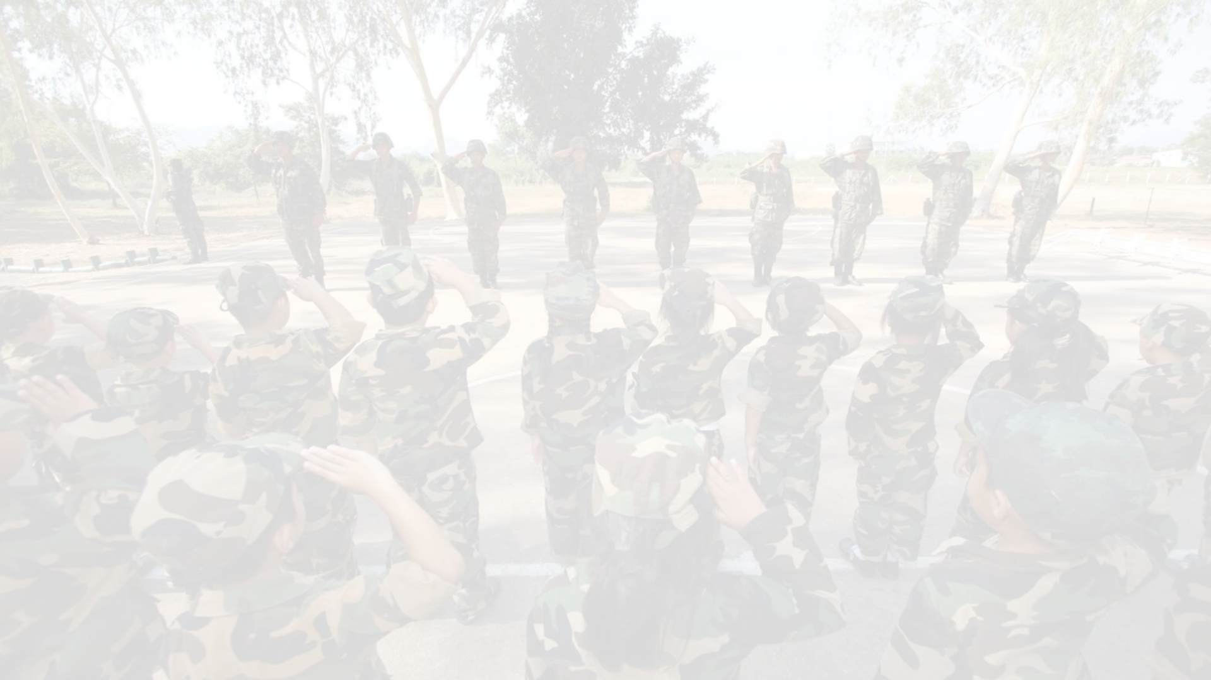
Section 1 : Domestic Security and Internal
Stability of the State

Slide 4
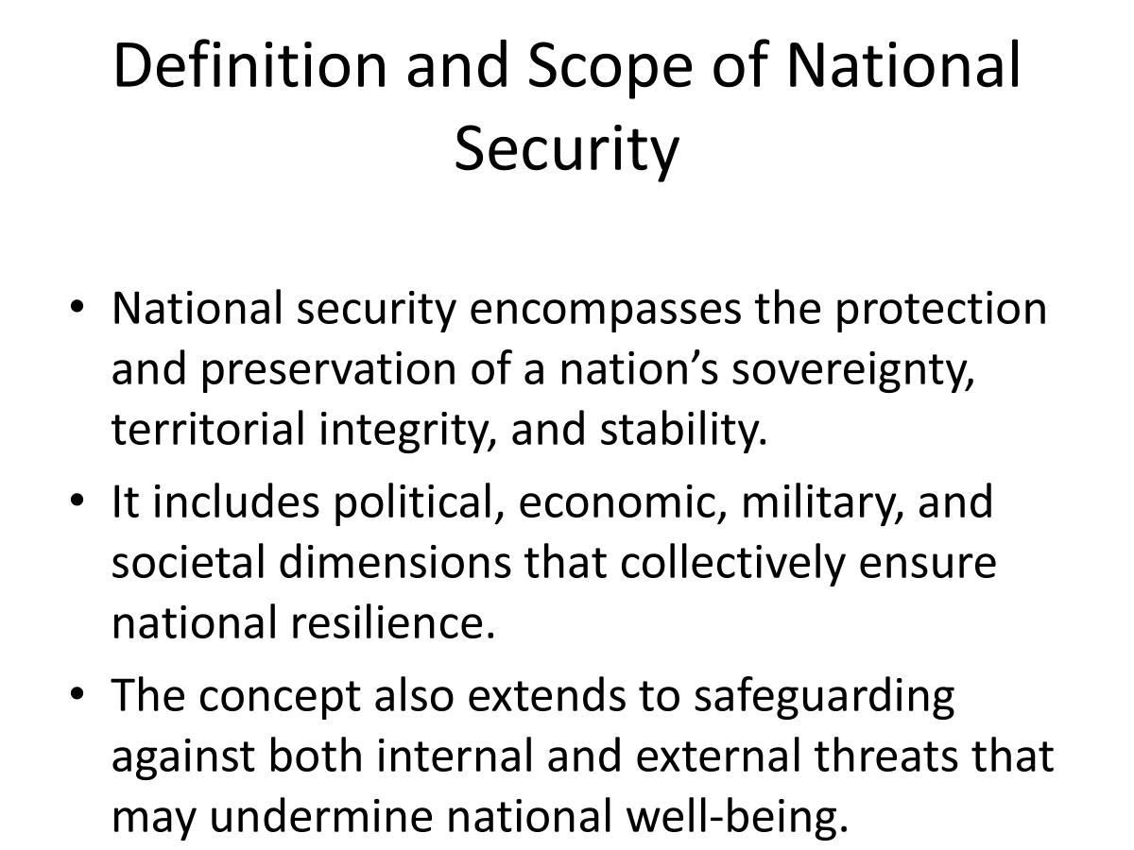

Slide 5
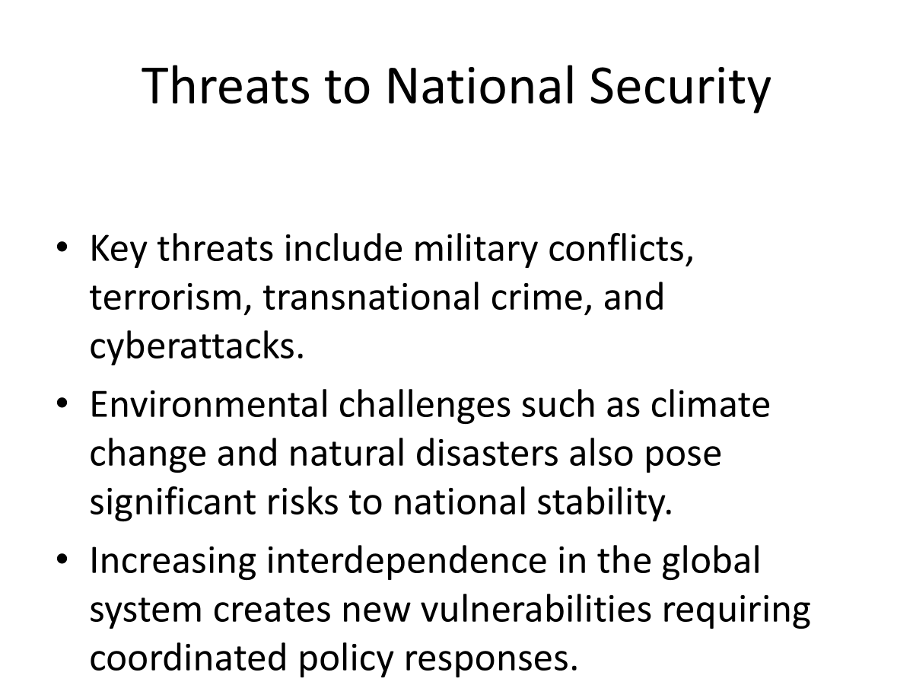

Slide 6
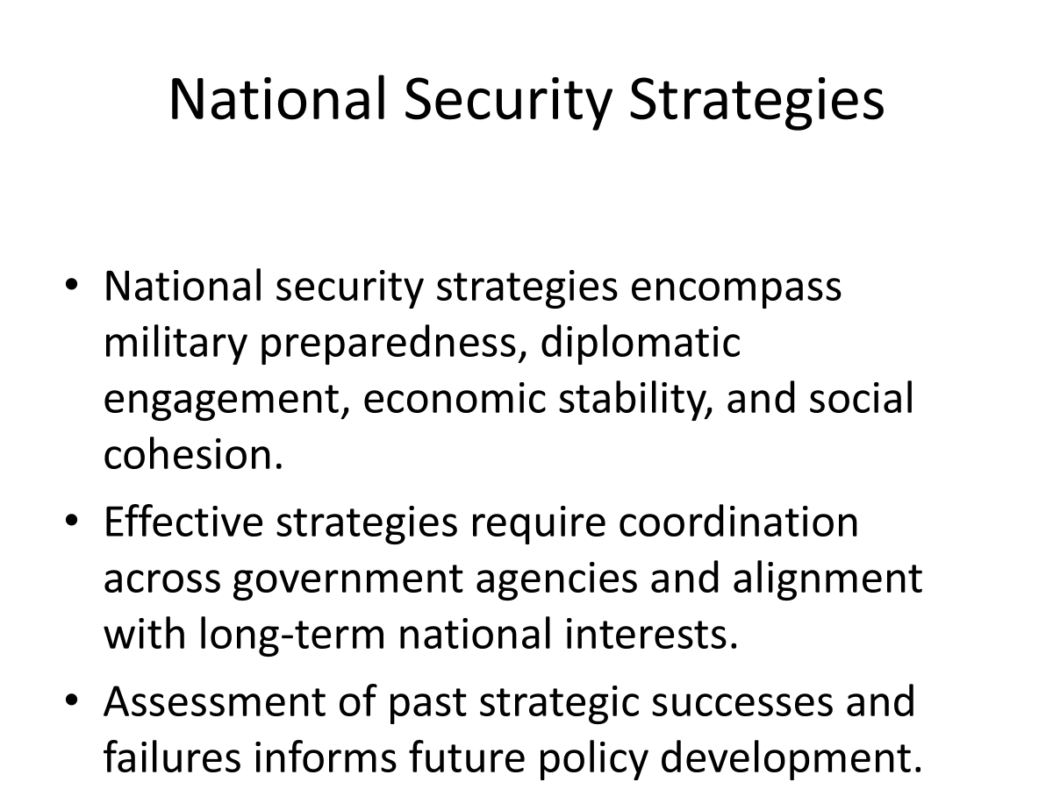

Slide 7
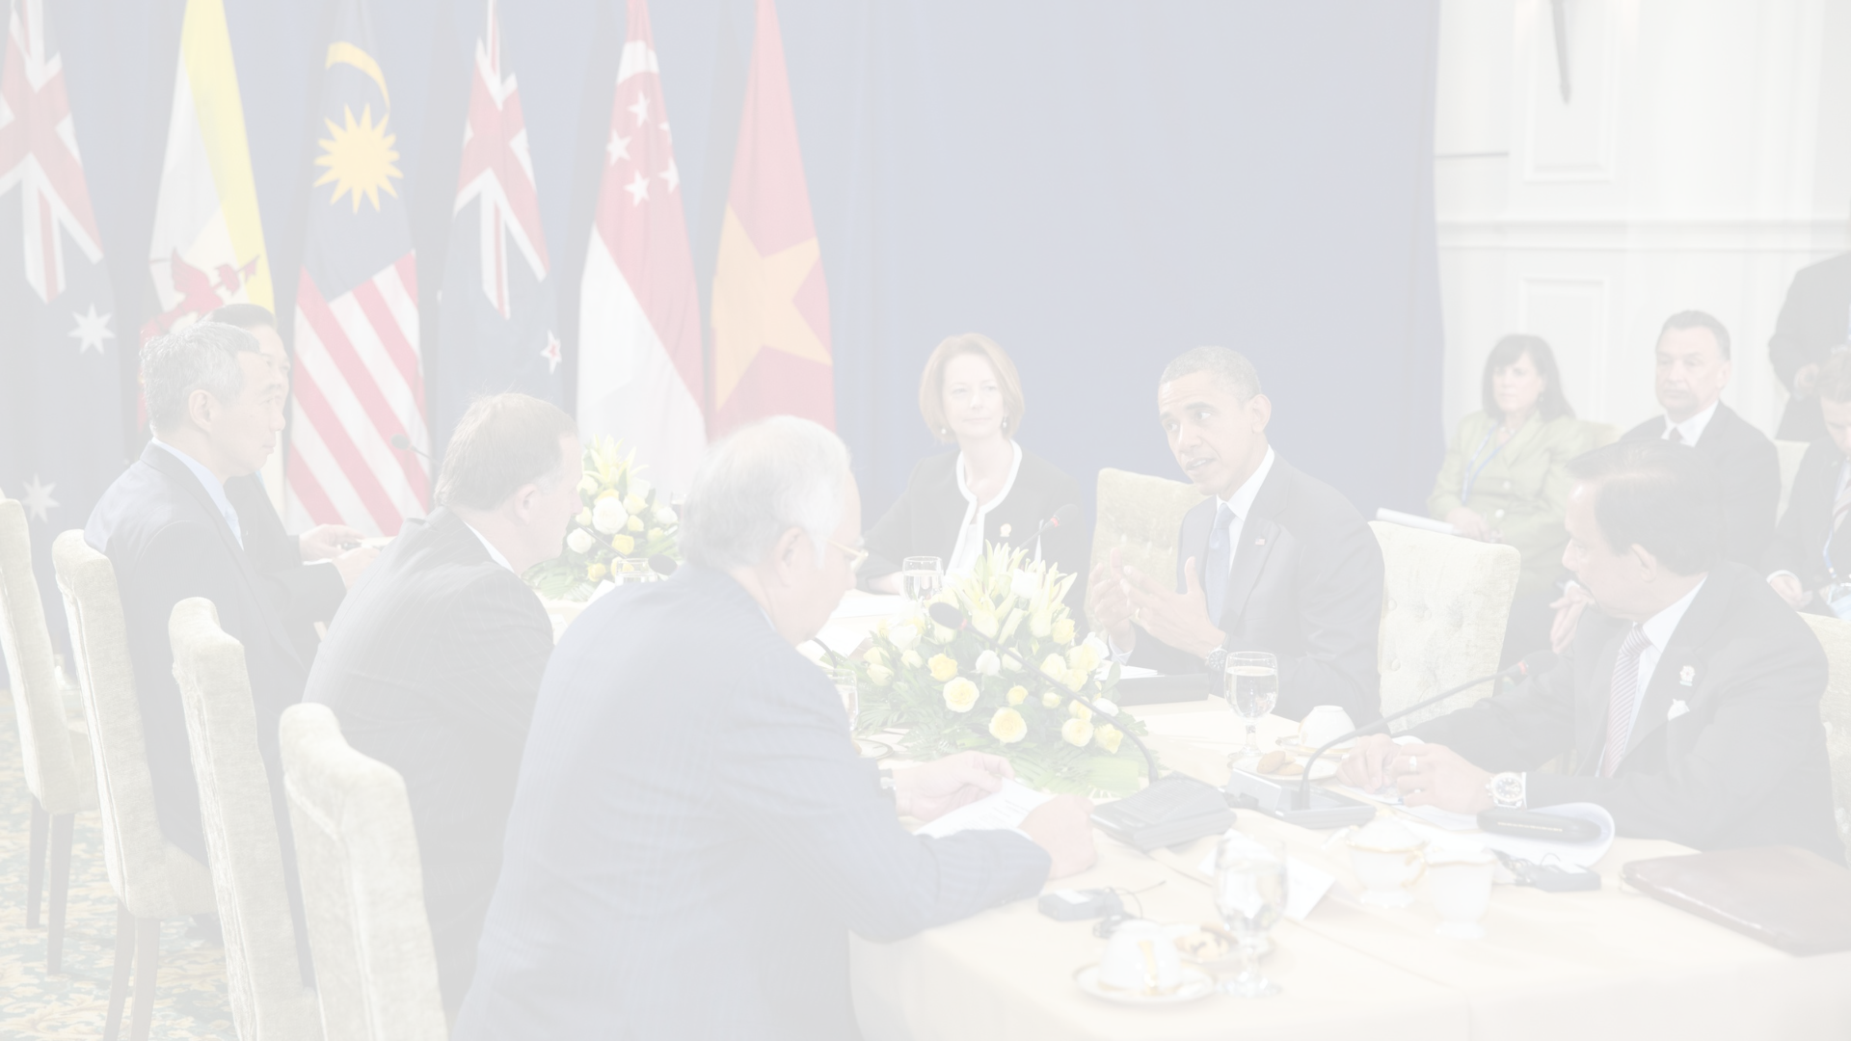
Section 2 : International relations in the
political domain

Slide 8
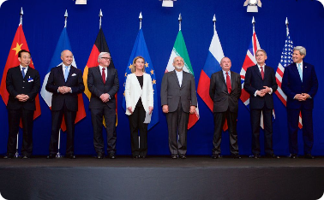
Foundations of International Relations
“Foundations of International Relations” refers to the core principles, theoretical frameworks, and analytical approaches used to understand interactions among states, international organizations, and non-state actors. It encompasses the study of power, diplomacy, global governance, security, and economic interdependence. The field examines how historical contexts, political structures, and normative ideas shape state behavior and international outcomes. It also explores the mechanisms through which cooperation, conflict, and negotiation occur in the global arena. Overall, it provides a conceptual basis for analyzing contemporary issues in world politics.
Explaining the evolution of the international system and discussing major theories in international relations

Slide 9
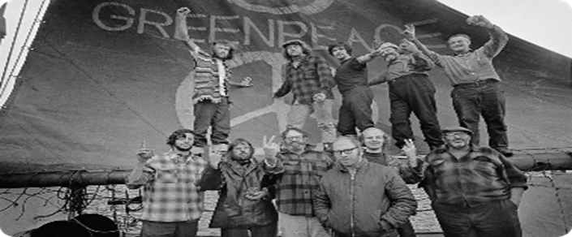
Actors in International Relations
Identifying participants in international relations involves distinguishing between state actors—such as national leaders, ambassadors, consuls, and ministers of foreign affairs—and non-state actors, including intergovernmental organizations and multinational corporations. These actors play varying roles in shaping global political, economic, and diplomatic processes

Slide 10
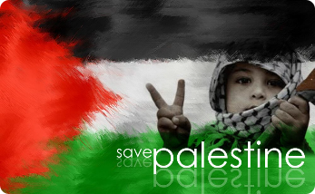
International Conflict and Cooperation
“International Conflict and Cooperation” refers to the study of how states and global actors engage in both adversarial and collaborative interactions within the international system. It examines the causes of conflicts—such as power struggles, security dilemmas, territorial disputes, and ideological differences—as well as the mechanisms that facilitate cooperation, including diplomacy, treaties, and international institutions. This field analyzes why wars occur, how peace is negotiated, and how collective action emerges in areas like trade, security, and environmental protection. For example, the Russia–Ukraine conflict illustrates geopolitical rivalry, while the Paris Agreement demonstrates global cooperation on climate change. Overall, the concept highlights the dual nature of international relations, shaped by both competition and interdependence.
Exploring the causes of international conflict involves analyzing the political, economic, and ideological factors that drive tensions between states. This also includes a discussion of conflict-resolution mechanisms and pathways to cooperation, such as diplomacy, negotiation, mediation, and the development of international norms and institutions that facilitate peaceful interactions.

Slide 11

Global Governance
Analyzing the role of international institutions—such as the United Nations and the World Trade Organization—in global governance involves examining how these organizations shape international norms, coordinate state behavior, and provide mechanisms for managing global issues. It also requires discussing the challenges and effectiveness of global governance, including questions of institutional legitimacy, unequal power relations, enforcement limitations, and the capacity of these institutions to respond to complex and evolving transnational problems

Slide 12
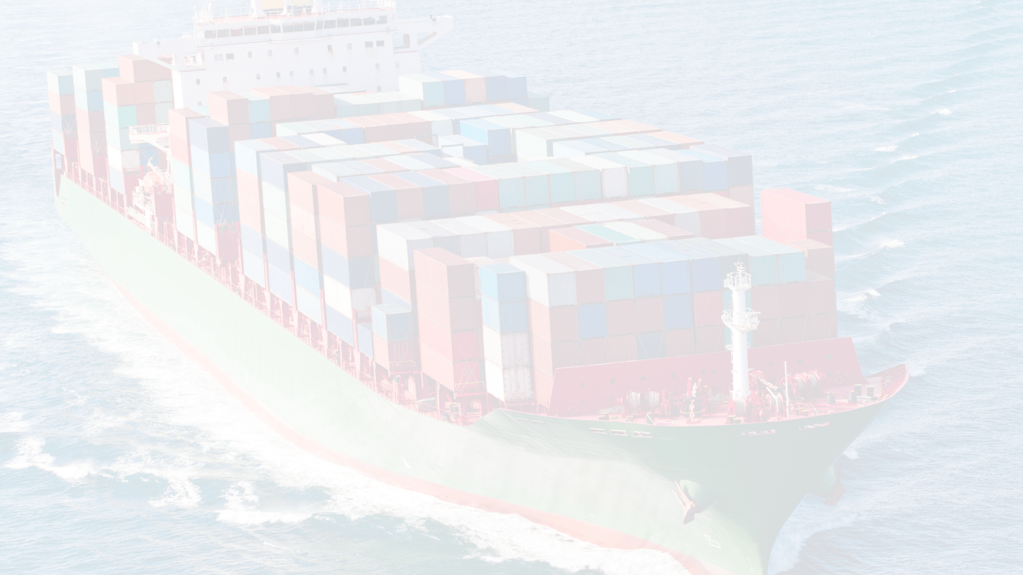
Section 3 : ​​Trade management

Slide 13

Trade management (1)
Foundations of International Trade
“Foundations of International Trade” refers to the fundamental principles, theories, and structural mechanisms that explain how and why countries engage in the exchange of goods, services, capital, and technology across national borders. It encompasses key economic concepts such as comparative advantage, factor endowments, market integration, trade policies, and institutional frameworks that shape global economic interactions and influence patterns of production, consumption, and economic development
)

Slide 14

Trade management (2)
Trade Policies and Trade Agreements
“Trade Policies and Trade Agreements” refer to the strategic measures, regulatory frameworks, and formal arrangements adopted by governments and international bodies to govern cross-border economic activities. Trade policies encompass national rules related to tariffs, quotas, subsidies, standards, and regulations aimed at shaping the flow of goods, services, and investments. Trade agreements, whether bilateral, regional, or multilateral, constitute legally binding accords that establish mutually agreed-upon rules designed to reduce trade barriers, promote economic cooperation, enhance market access, and support a stable and predictable international trading system.

Slide 15
Trade management (3)
Trade and Economic Development
Analyze the impacts of international trade on economic development, and discuss the roles of multinational corporations in the global economy. This includes examining how trade liberalization, cross-border production networks, and global value-chain integration influence national growth trajectories, industrial upgrading, and income distribution. It also involves evaluating how multinational corporations contribute to capital flows, technology transfer, employment generation, and competitive dynamics, while considering concerns related to market dominance, regulatory challenges, and developmental inequalities among countries

Slide 16
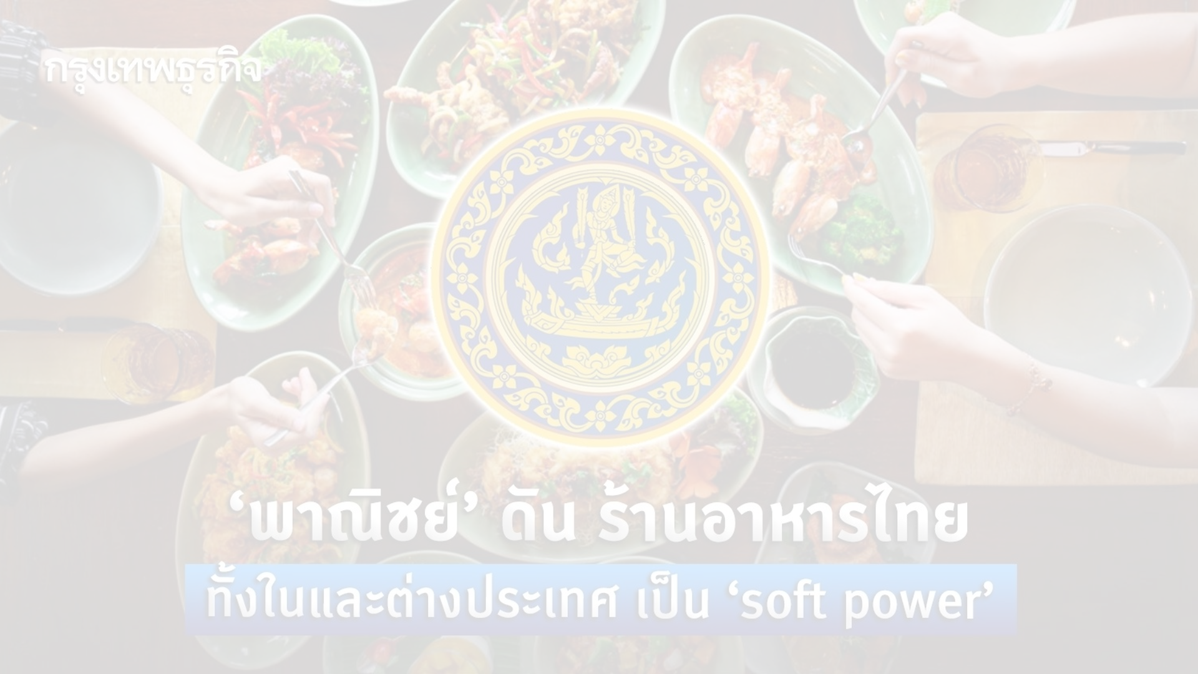
Section 4 : Social and cultural dimensions

Slide 17


Cultural Diplomacy
Define the role of cultural diplomacy in international relations and examine examples of successful cultural diplomacy initiatives as examples below :
- South Korea’s Korean Wave (Hallyu) Diplomacy South Korea’s government strategically supports the global spread of K-pop, K-dramas, films, and culinary culture as instruments of cultural diplomacy. This has improved Korea’s international standing, boosted cultural exports, and fostered international cooperation in media, education, and tourism.
- United States’ Fulbright Program. The Fulbright Program facilitates international academic exchange through scholarships for students, academics, and professionals. By fostering educational collaboration and intercultural understanding, the program has become a cornerstone of U.S. Cultural diplomacy.

Slide 18


Globalization and Cultural Exchange
Globalization has transformed cultural landscapes by accelerating the transnational movement of ideas, values, and practices. This process enhances access to diverse cultural expressions and promotes intercultural understanding, thereby contributing to creativity and the development of broader global perspectives. Nevertheless, globalization also generates notable challenges, including the potential dilution of local cultural identities, the marginalization of traditional practices, and imbalances in cultural influence. Thus, while cultural exchange yields substantial benefits for knowledge sharing and social enrichment, it must be managed carefully to safeguard cultural integrity and support equitable intercultural relations.

Slide 19

Social Movements and Global Issues
Social movements play an increasingly significant role in addressing global issues by mobilizing public pressure, shaping transnational advocacy networks, and influencing the policy agendas of states and international organizations. These movements can challenge traditional state-centric norms by elevating concerns such as human rights, climate justice, and gender equality into global diplomatic discussions. Their interventions often reshape international relations by encouraging states to adopt more accountable and cooperative behaviors in response to global social demands. For example, the global climate movement (e.g., Fridays for Future) has pressured governments to strengthen climate commitments, while the #Me Too movement has sparked international reforms on gender-based violence. Overall, social movements act as non-state actors that redefine global governance and the dynamics of international cooperation.

Slide 20
what is soft power ?
Soft power means a country’s ability to influence others without using force or pressure. Instead of military or economic power, soft power works through attraction, such as culture, values, education, reputation, and diplomacy.
Explanation : Soft power is the ability of a country to make others want what it wants by inspiring trust, admiration, or respect. It uses things like culture (movies, music, food), good foreign relations, and national values to create a positive image, so other countries choose to cooperate willingly.

Slide 21
